Slide 1
Google, Amazon and more Employee Reviews
Team 5: Data Analysis and Visualization
Contributed By:
Manogna Mantripragada, Balaji Mudaliyar, Pratik Mahajan and Supriya Murty

Slide 2



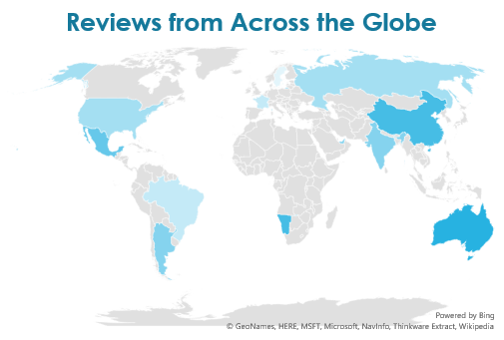
What is our data about?
Google
Over 67K Employee Reviews
Netflix
Amazon
Facebook
Apple
Microsoft
Review Date

Slide 3



What do we want to find?

Slide 4


How do we do it?

Slide 5


Polarity
0
-1
+1

Slide 6
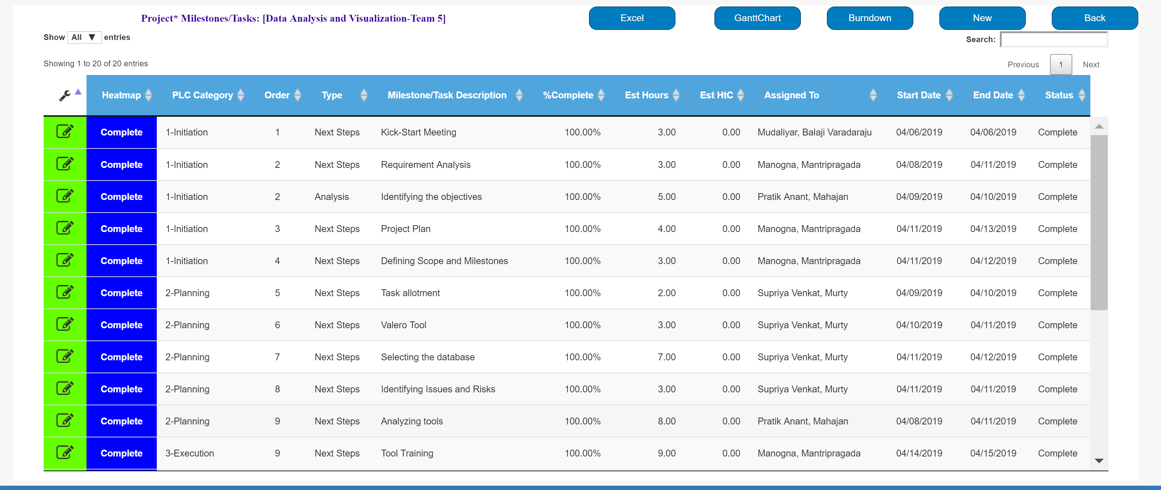
Our Plan

Slide 7
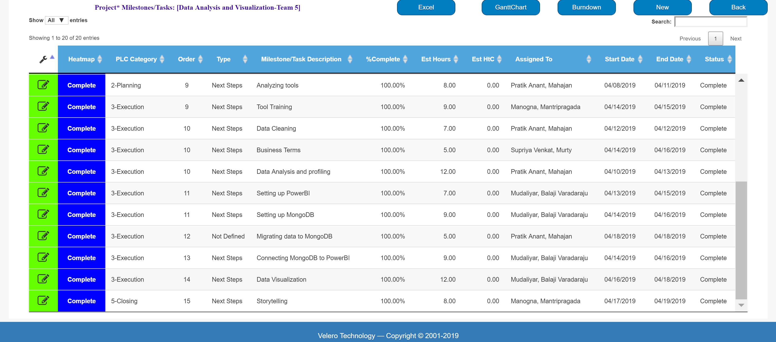
Our Plan

Slide 8
Why MongoDB
Our data was in text format which we had to save in a document format for ease of processing.
Having a long term vision, we wanted to choose a database that would be scalable incase of more data to come our way
It would eliminate the complex operations and simplify our process.
Comfort of the team.

Slide 9








Process

Slide 10
Issues and Risks
Issues | Risks
Inconsistent data. | Risk of not choosing the right Database
Power BI Installation on systems | Data migration connectivity issue while connecting MongoDB to PowerBI
Risk of Missing on deadlines | Time allocation and Management for every team member and task
 | Team not familiar with the PowerBI

Slide 11
Challenges we faced:
Learning how to use the Mongo DB and Power BI from Scratch
Migrating data from MongoBD to Power BI
Familiarizing how to plot charts that would present our findings.
Meeting deadlines a few times
Team being preoccupied with other tasks

Slide 12
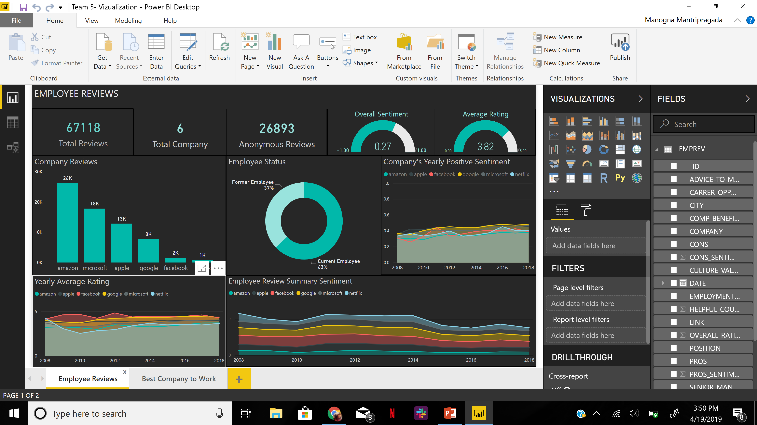
Our Findings

Slide 13
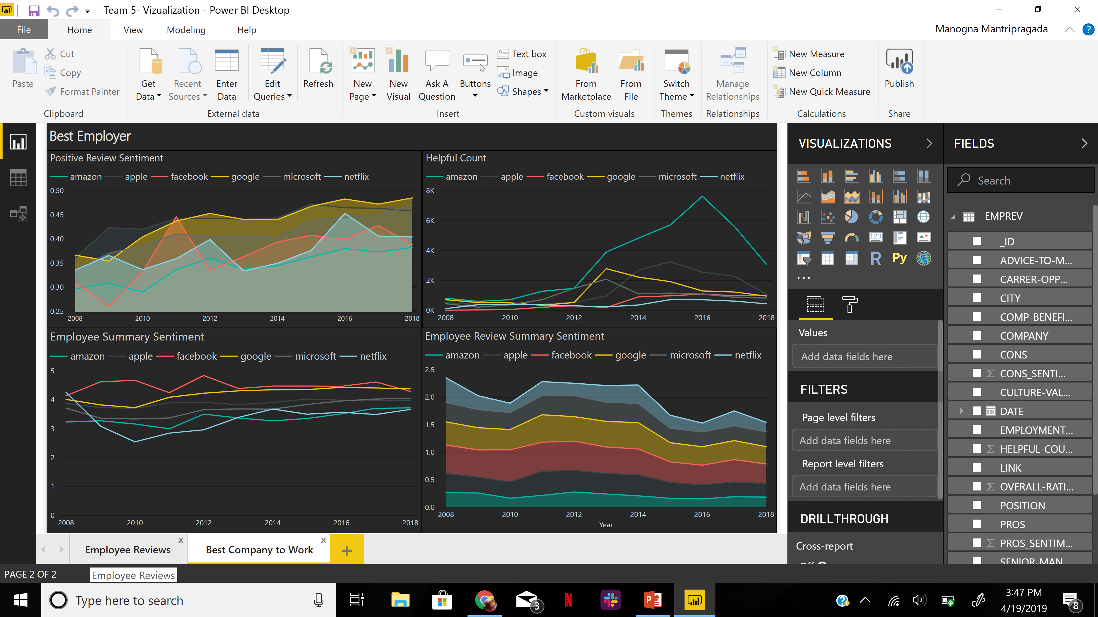
Our Findings

Slide 14
Deliverables Checklist
Deliverables:
Each group is expected to complete this assignment using below instructions :
1- Define your project plant - Define tasks and assign them to members of your team with delivery dates.
2 - Create a project in Velero's tool and enter above information
3 - Assign activities to your project as it was demonstrated in previous lecture
4 - Members of each team is expected to post their time using the Velero's timesheet
5 - Choose any database from list of big data database (No RDBMS Please)
6 - Install selected database
7 - Load the sample data ( you may use any utility or programming languaue)
8 - Create a business term dictionary for each data point define the business term and definition of the term
9 - Using BI tool (Power BI) define a dashboard demonstrate your understanding of the data

